Slide 1
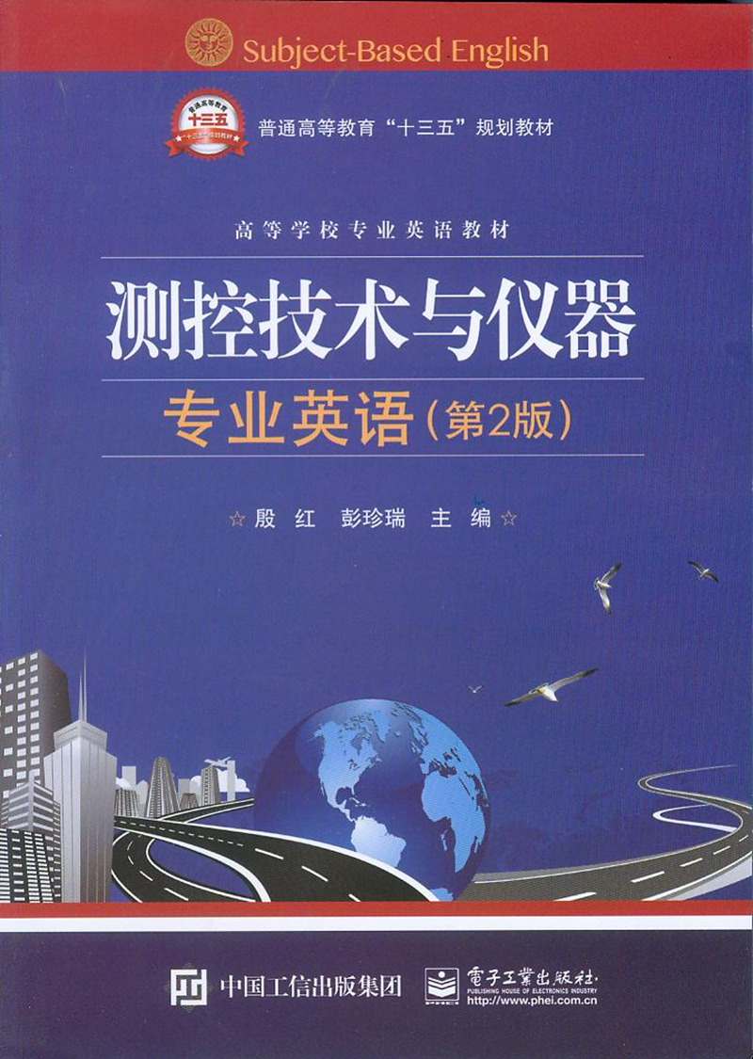
Unit3 Smart Sensors

Slide 2
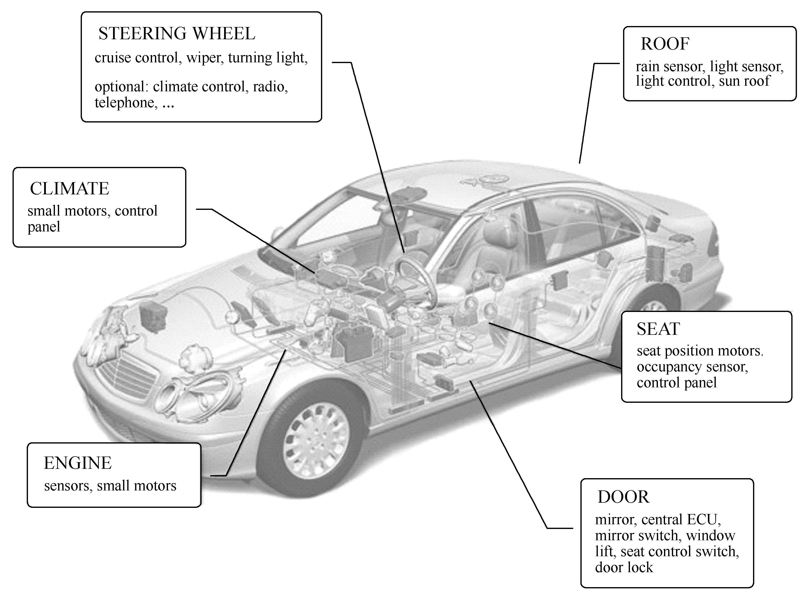
Unit3 Smart Sensors

Slide 3
Introduction
Just about everything today in the technology area is a candidate（申请求职者，候选人；报考者）for having the prefix （前缀）smart added to it. The term smart sensor was coined in the mid-1980s, and since then several devices have been called smart sensors.
就像今天技术领域的所有事物都想加上智能的头衔一样，术语智能传感器产生于20世纪80年代中期，从那时起，有些装置就称为智能传感器。

Slide 4
The intelligence required by such devices is available from microcontroller unit (MCU), digital signal processor (DSP), and application-specific integrated circuit (ASIC) technologies developed by several semiconductor manufacturers.
句中microcontroller unit(MCU)意为“微控制器单元”，digital signal processor (DSP)意为“数字信号处理器”，application-specific integrated circuit (ASIC)意为“特殊应用集成电路”。
全句译为：这些设备所具有的智能源于半导体生产厂家开发的微控制器（MCU）、数字信号处理器（DSP）和特殊应用集成电路（ASIC）技术。

Slide 5
Some of those same semiconductor manufacturers are actively working on smarter silicon devices for the input and output sides of the control system as well. The term microelectromechanical system (MEMS)（微机电系统）is used to describe a structure created with semiconductor manufacturing processes for sensors and actuators.
这些半导体制造商也积极地为控制系统的输入和输出生产更智能的硅器件。术语微机电系统(MEMS)用于描述传感器和执行器的半导体制造结构。

Slide 6
Before the availability of microelectronics, the sensors or transducers used to measure physical quantities, such as temperature, pressure, and flow, usually were coupled（连接，联结，联系）directly to a readout device, typically a meter that was read by an observer.
在微电子技术使用之前，传感器或变送器用于测量温度、压力、流量等物理量，通常直接与装置连接，一般是由观测者读数的仪表。

Slide 7
Commonly used definitions for the terms sensor and transducer must be the first in the list of many terms that will be defined. A transducer is a device that converts energy from one domain into another, calibrated（校准）to minimize the errors in the conversion process. A sensor is a device that provides a useful output to a specified measurand.
传感器和变送器的定义通常必须位于许多需要定义的术语清单的首位。变送器是将能量从一个领域转换到另一个领域的设备，在转换过程中将误差校准到最小。传感器是为指定被测量提供有用输出的设备。

Slide 8
The sensor is a basic element of a transducer, but it also may refer to a detection of voltage or current in the electrical regime（物理条件，环境，组织方法；管理体制，政体）that does not require conversion. Sometimes, the terms are used synonymously（同义地）, because energy conversion is part of every device that is discussed.
传感器是变送器的一个基本元件，但它也指无需转换的电气结构中电压或电流的测量。有时，这些术语是同义的，因为能量转换是讨论的每个装置的一部分。

Slide 9
The definition of smart sensor (intelligent transducer) has not been as widely accepted and is subject to misuse. However, an Institute of Electrical and Electronics Engineers (IEEE) (电气和电子工程师协会)committee has been actively consolidating terminology（专门用语，术语，术语学，术语的正确使用，术语用法）that applies to microelectronic sensors.
智能传感器（智能变送器）的定义还没有被广泛接受，还容易被滥用。然而，电气和电子工程师协会(IEEE)积极地加强应用于微电子传感器的术语使用。

Slide 10
The recently approved IEEE 1451.2 specification defines a smart sensor as a sensor that provides functions beyond those necessary for generating a correct representation of a sensed or controlled quantity. This function typically simplifies the integration of the transducer into applications in a networked environment.
最近通过的IEEE 1451.2标准将智能传感器定义为：智能传感器是一种除了具有产生正确的感知量和被控量表达形式等这些必需的功能外，还能提供更多特殊的功能，简化传感器与网络环境的整合应用的传感器。

Slide 11
Smart sensor configurations
The sensor provides an input to a controller with the desired strategy in its memory, and the controller drives an output stage to modify or maintain the status of a load, such as a light, a motor, a solenoid, or a display.
传感器按存储器中的指定策略为控制器提供输入，控制器产生输出修改或维持载荷的状态，如指示灯、电机、电磁阀或显示器。

Slide 12
The smart sensor models developed by several sources have as many as six distinct elements for analog sensors. As shown in Figure 3.3, in addition to the sensing element and its associated amplification and signal conditioning, an A/D converter, memory of some type, and logic (control) capability are included in the smart sensor. Once the signal is in digital format, it can be communicated by several communication protocols（通信协议）.
源于多学科的智能传感器模块有6个不同模拟传感器的组件之多。如图3.3所示，除了传感元件和相应的信号放大器、信号调理器而外，智能传感器也包括A/D 转换器、各种类型存储器和逻辑（控制）器。如果信号是数字形式，可有几种通信协议进行通信。

Slide 13
Integrated sensor
Increasing the performance and reliability and reducing the cost of electronic circuits through increased integration are standard expectations for semiconductor technology. In the area of semiconductor sensors, however, that integration has been limited to Hall-effect and optoelectronic devices.
通过不断增加的集成技术使性能和可靠性不断增加，电路成本不断降低，是半导体技术的期望标准。在半导体传感器领域中，这种集成仅限于霍尔传感器和光电子设备中。

Slide 14
The term microelectromechanical systems, or sometimes simply microsystems, is used to describe the structures and functions provided by micromachining and the addition of microelectronics to those structures.
微机电系统或简称微系统，通常描述微机械和与之结合的微电子技术所构成的结构和功能。

Slide 15
New packages must be developed for smart sensors to accommodate the additional connections for power, ground, output, diagnostics, and other features that the combination of technologies can provide.
必须开发新组件以便智能传感器能适应对电源、接地、输出、诊断工具的连接，以及适应技术组合可提供的其他性能的连接。

Slide 16
Sensors have few, if any, commonly accepted packages. Instead, each supplier provides a unique pinout and form factor. The problem is exacerbated by the addition of more features to sensors, either through integration or by the addition of circuitry.
传感器（如果有）很少有通用的组件。相反，每个供应商都提供特有的引出线和组成部分。无论是通过集成还是电路的增加，使传感器性能的增加，都让这个问题更加严重。

Slide 17
Prior to the era of sensor integration, products that combine technology at the package level, rather than at the silicon level, have been the industry norm. A hybrid（混合，合成，杂交，杂种）or module solution has the advantage of using proven available technology to achieve a more sophisticated product solution.
在传感器集成时代之前，封装级别而不是硅技术级别的组合技术产品是工业标准化的。混合或模块化解决方案具备用已证明可用的技术来实现更成熟的生产方案的优点。

Slide 18
That may be in a printed circuit board(印刷电路板)or ceramic substrate(陶瓷衬底，陶瓷基片）form. Figure 3.4 shows the steps that can be taken toward a higher level of monolithic（整体式，单片，整体的，庞大的）integration.
这可以是印刷电路板或陶瓷基片的形式。图3.4表示了向更高水平发展的庞大集成的步骤。

